Slide 1
Artificial intelligent lab
Prepare by
Zobeda hatif naji
Computer department
Engineering college

Slide 2
outline
Biological Neural Network
Represent nn with artificial neural
Activation function
Neuron Model
Neural network

Slide 3
Biological Neural Network:

Slide 4
Represent nn with artificial neural :

Slide 5
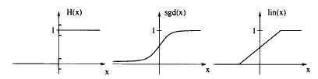
Activation function:
Several activation functions: perceptron activation H, standard sigmoidal function sgd, and semilinear activation lin; all three functions are squashing functions.

Slide 6
Activation function:
The scaled version tanh(x) = 2. sgd(2x) - 1 are common functions of this
type. A more precise approximation of these sigmoidal activations which is
sometimes considered in theoretical investigations is the semilinear ]unction

Slide 7
Activation function:
In practical applications the activation functions are similar
to the perceptron activation for large or small values and have a smooth
transition between the two binary values. The standard sigmoidal ]unction
sgd(x) = (1 + e^-x) ^-1

Slide 8
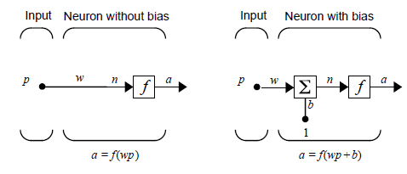
Neuron Model
Simple Neuron:A neuron with a single scalar input and no bias appears on the left below.

Slide 9
Neuron Model
The scalar input p is transmitted through a connection that multiplies its
strength by the scalar weight w, to form the product wp, again a scalar.
Here the weighted input wp is the only argument of the transfer function
f, which produces the scalar output a. The neuron on the right has a
scalar bias, b. You may view the bias as simply being added to the
product wp as shown by the summing junction or as shifting the function
f to the left by an amount b. The bias is much like a weight, except that
it has a constant input of 1.

Slide 10
Neuron Model
The transfer function net input n, again a scalar, is the sum of the
weighted input wp and the bias b. This sum is the argument of the
transfer function f. (Chapter 7 discusses a different way to form the net
input n.) Here f is a transfer function, typically a step function or a
sigmoid function, which takes the argument n and produces the output
a. Note that w and b are both adjustable scalar parameters of the neuron.

Slide 11
Neural network:
A network computes a mapping which is composed of several
simple functions computed by the single neurons. The activation functions of the single computation units are often identical
for all units or all but the output units, respectively.

Slide 12
Thank you for listing

